Slide 1
Micro Credit Loan : Customer selection - Prediction Model
Internship Batch-33
Created By : Rahul M

Slide 2
Problem statement
The Problem statement here is Telecom company is collaborating with an MFI to provide micro-credit on mobile balances to customers that has to be paid back in 5 days. Due to its various challenges there is a requirement of model to predict the probability of whether the customer will be defaulter or not. In order to improve the selection of customers for the credit, the client wants some predictions that could help them in further investment and improvement in selection of customers

Slide 3
EDA Steps and visualization
Imported libraries, loaded data and checked its shape. There were 209593 rows and 36 columns in total including label column.
Data types for all the dataset in checked and found 2 object type column which gives only single type data to the dataset and has no impact to the outcome. Dropped those columns and all the data types are of int and float now.
Found no missing values in the dataset, confirmed using heatmap. There were no missing values present in the dataset and count in all the columns are same.

Slide 4
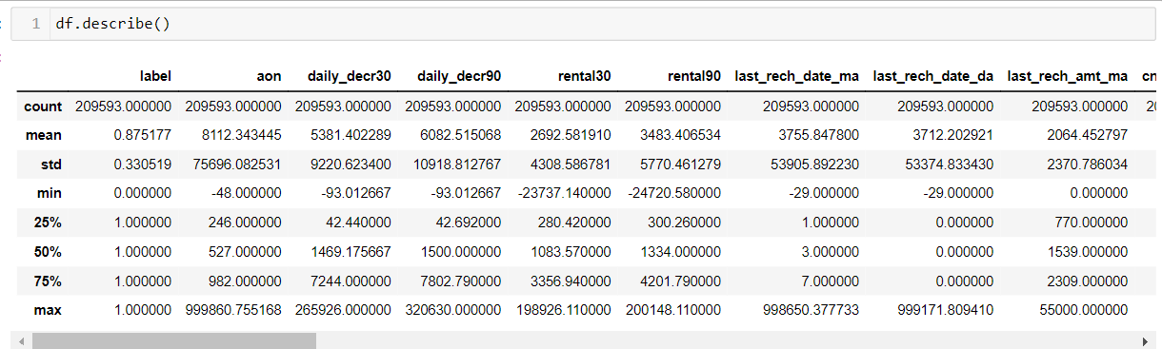
Statistical Inference
Count is same in all the columns. Many unrealistic datum are present. It is found that in most of the columns mean>median which results there is a high possibility of skewness. There is high difference between 75th percentile and max which results in outliers. Difference in mean and max is also high for many columns, so extreme outliers are present.

Slide 5
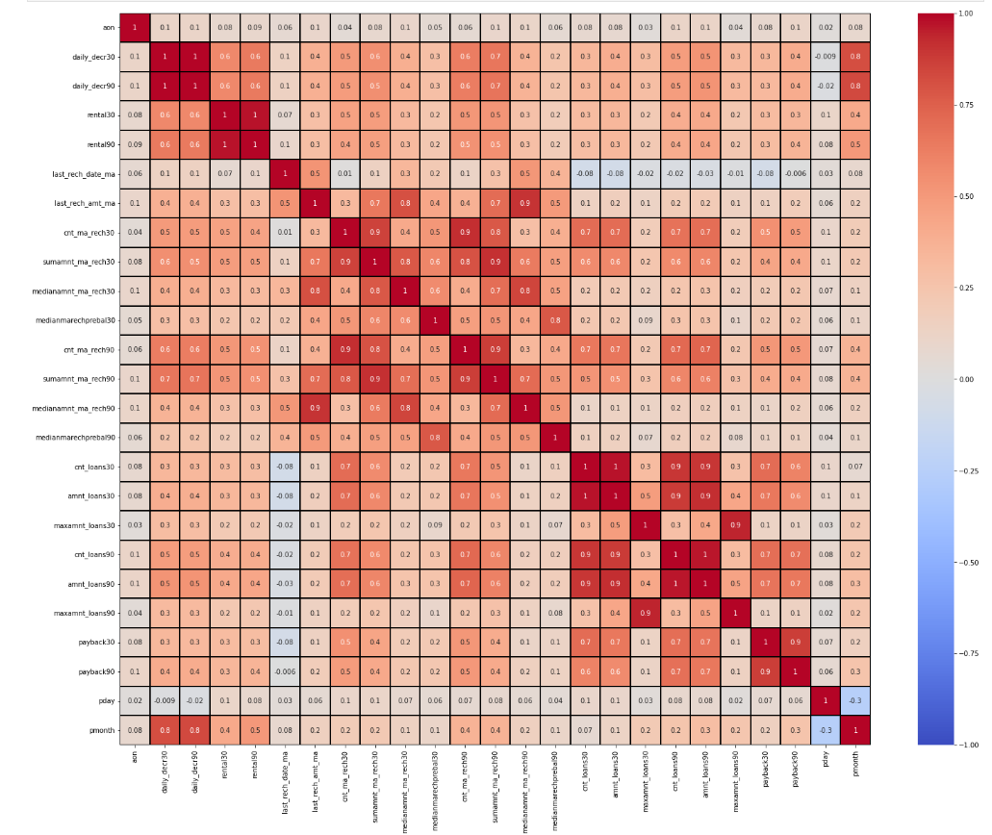
CORRELATION
12 columns are some what correlated that is also close to 0.2. Eleven features are correlated with zero with a value close to zero 9 features correlating with label have a very very close value to zero. This can be removed if needed. In general all the columns are very low correlated.

Slide 6
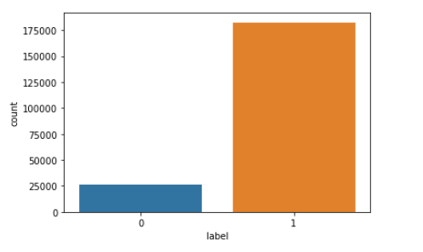
Balanced or imbalanced data
data seems to be imbalanced as we have low data on Defaulter which can be corrected by resample of data or else model f1 score need to be checked. This is be done Post EDA.

Slide 7
Distplot - skewness check
It is inferred that most of the columns are right skewed as shown in figure. In some of the columns distplot there are no probability function (kde) seen. We have to analyse that data and take a call on to whether just remove skewness and drop the column
Removing unrealsitic Data based on Analysis in pronlem
The Distplot graph shows almost all the datum are right skewed. So we have to remove skewness in remaining columns.

Slide 8
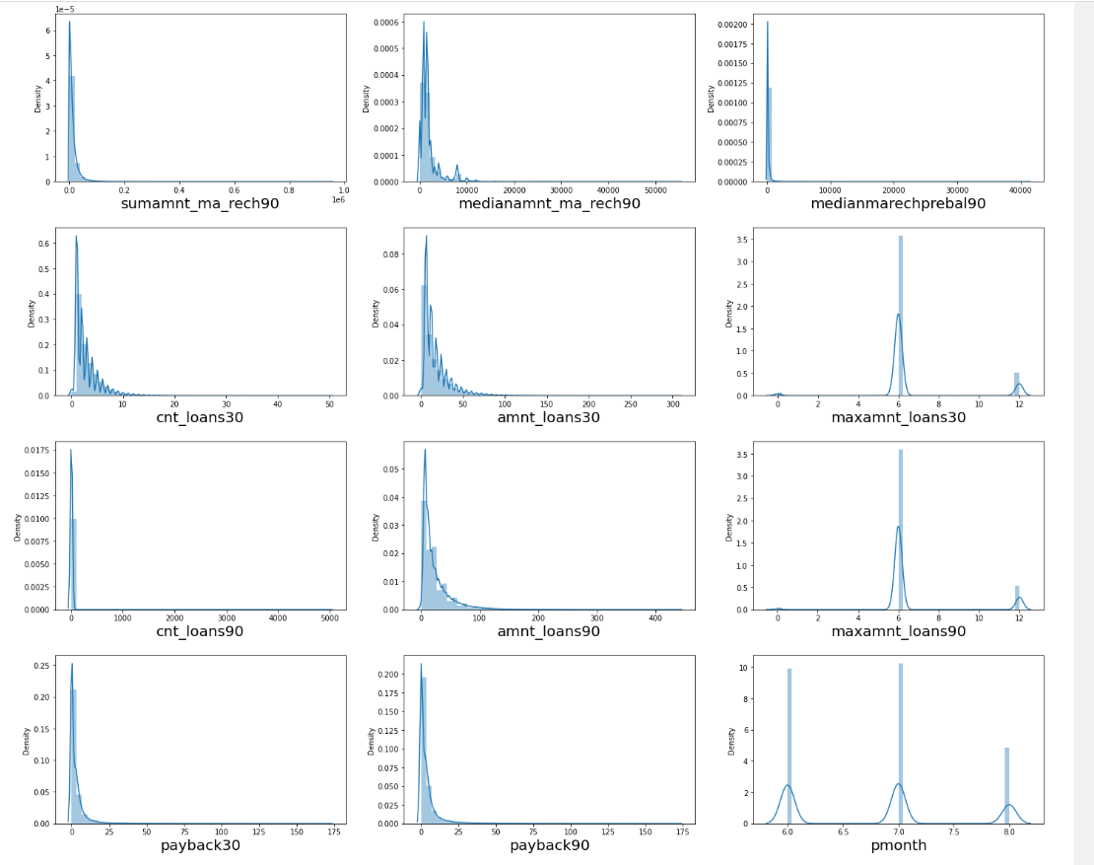
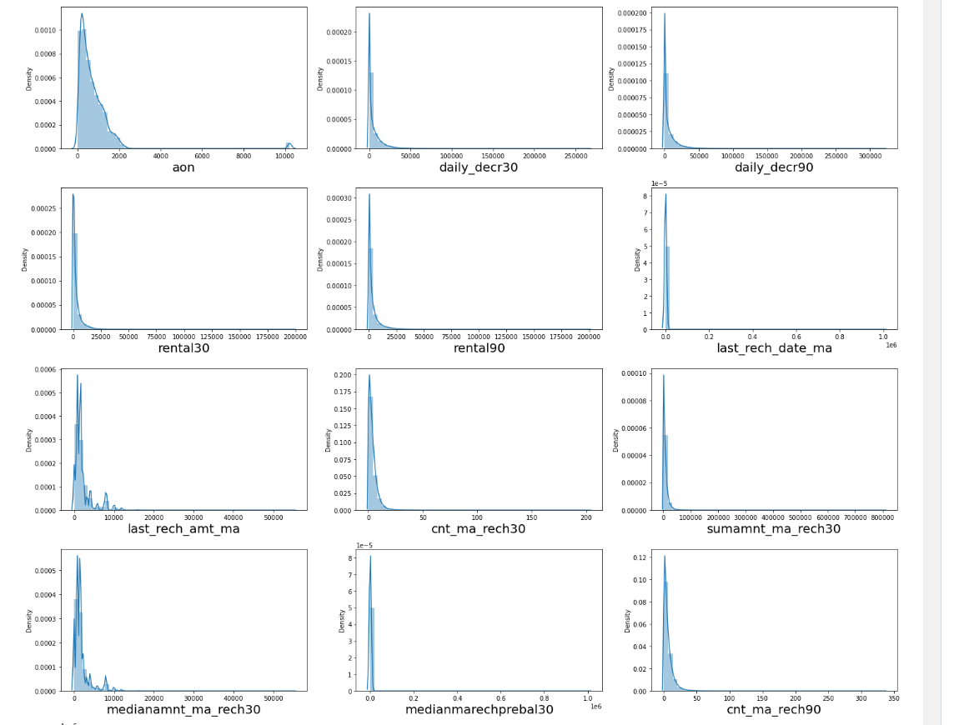
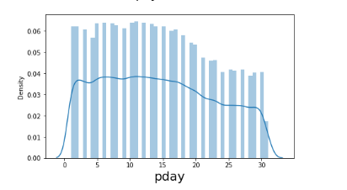
Skewness check

Slide 9
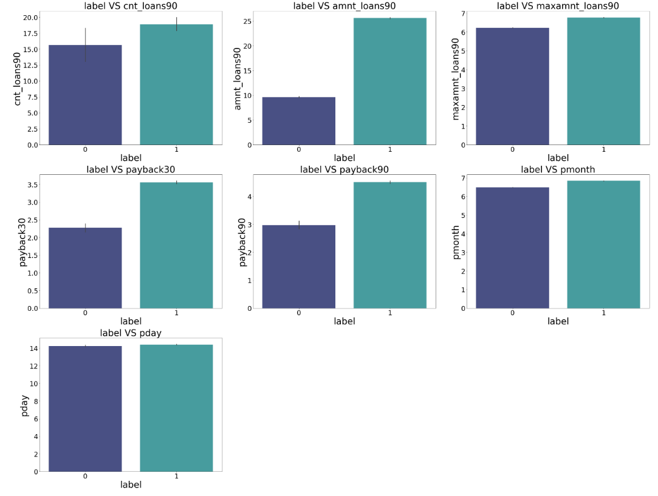
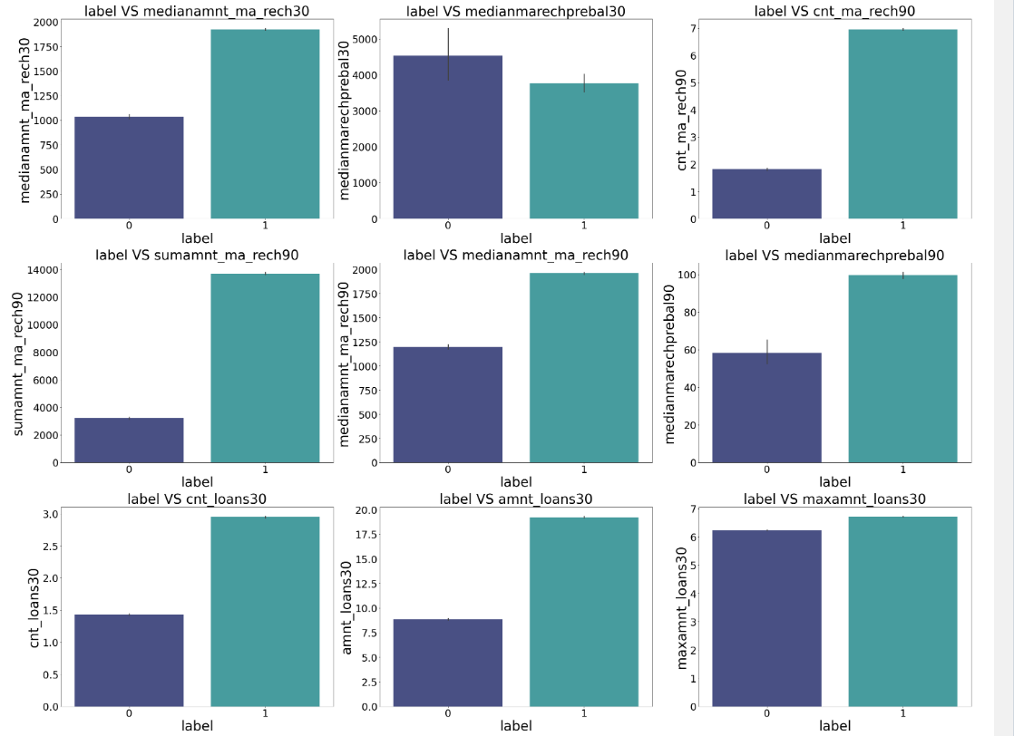
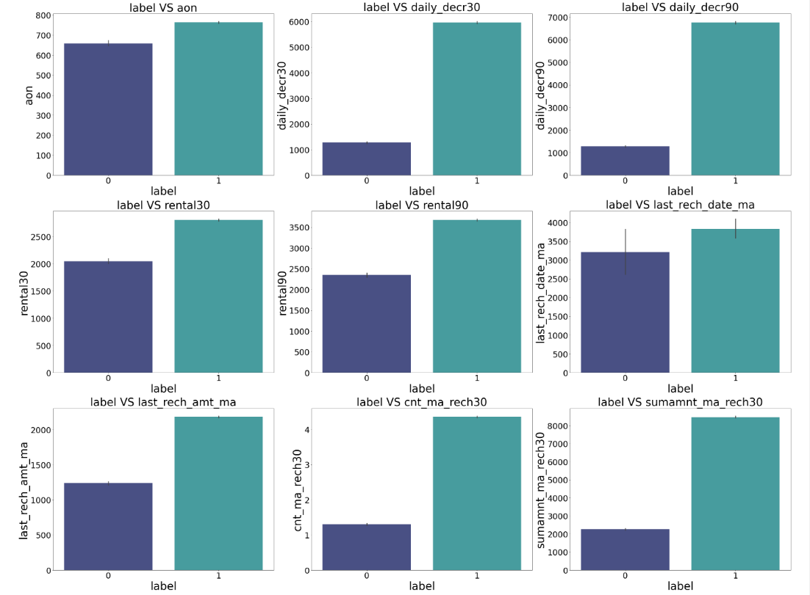
boxplot

Slide 10
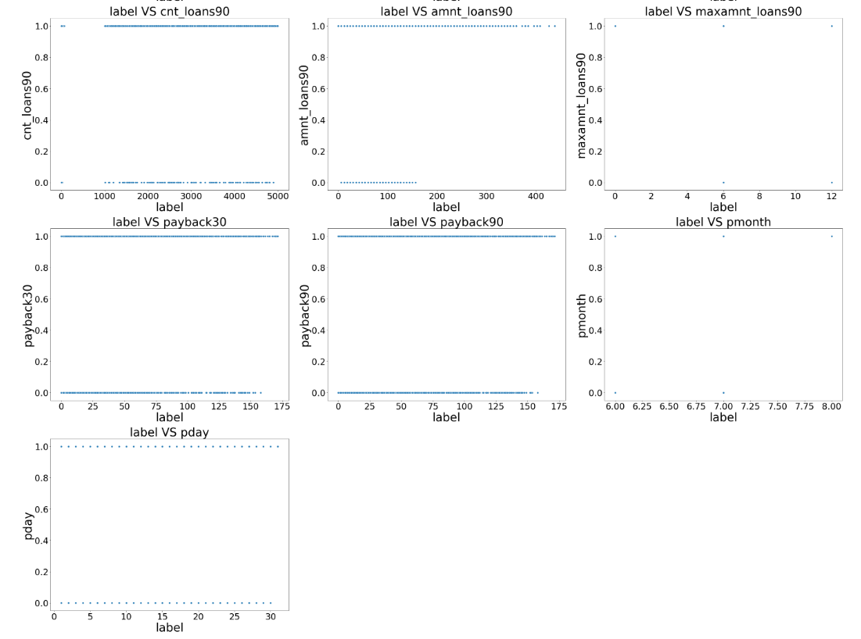
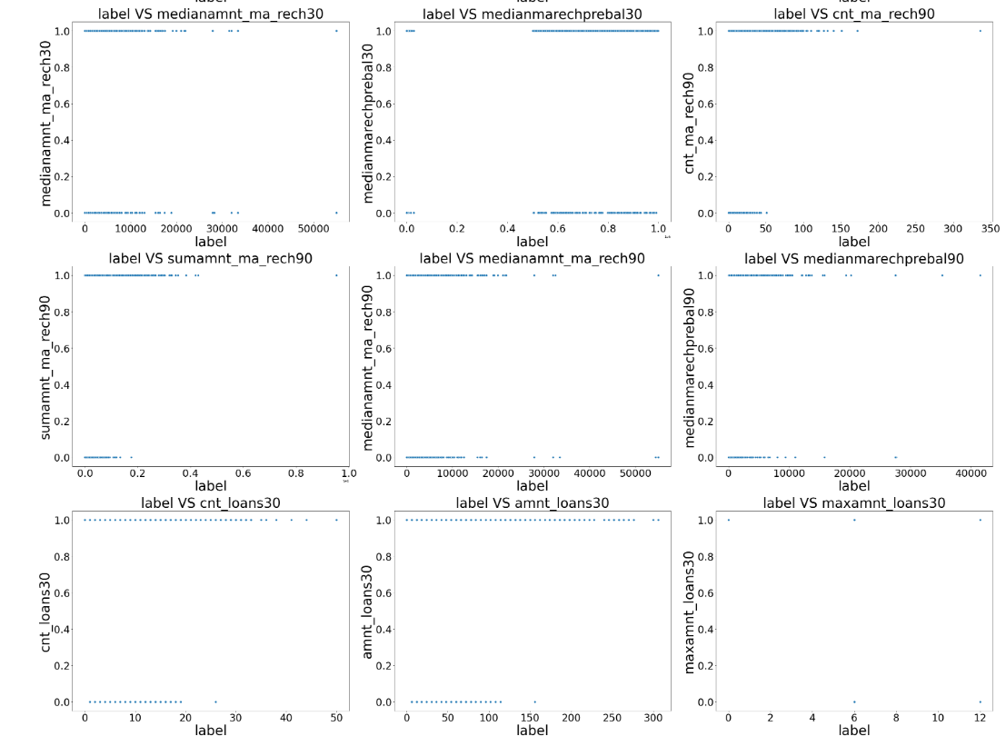
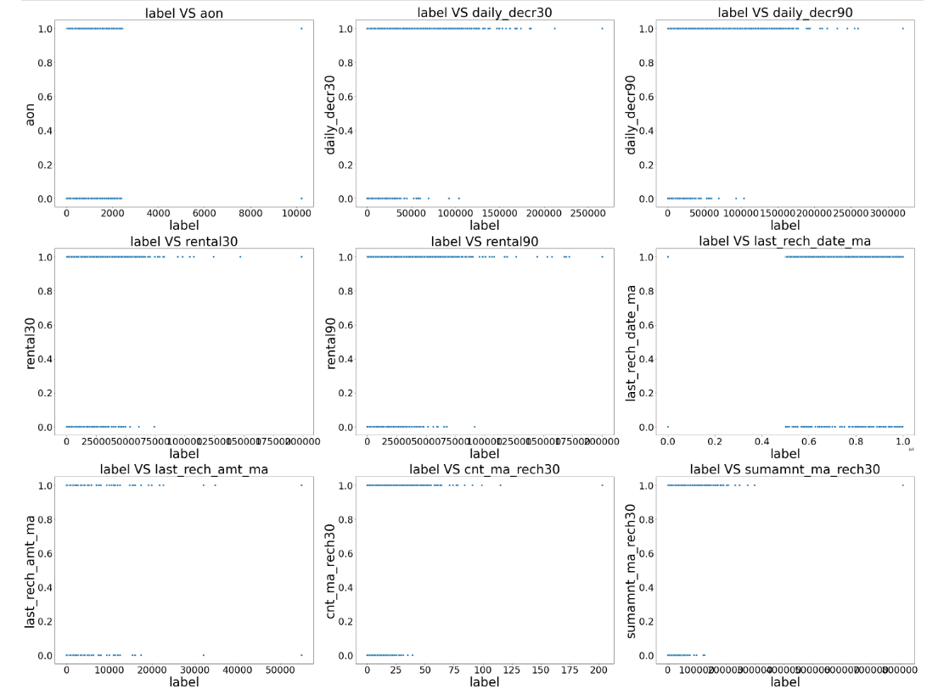
Scatterplot

Slide 11
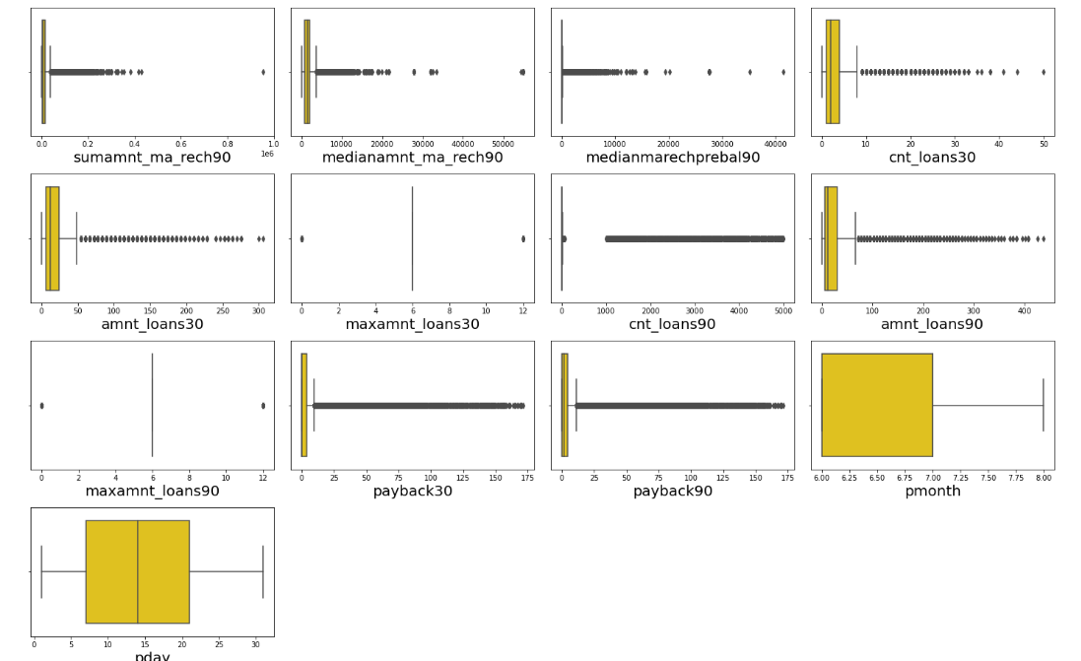
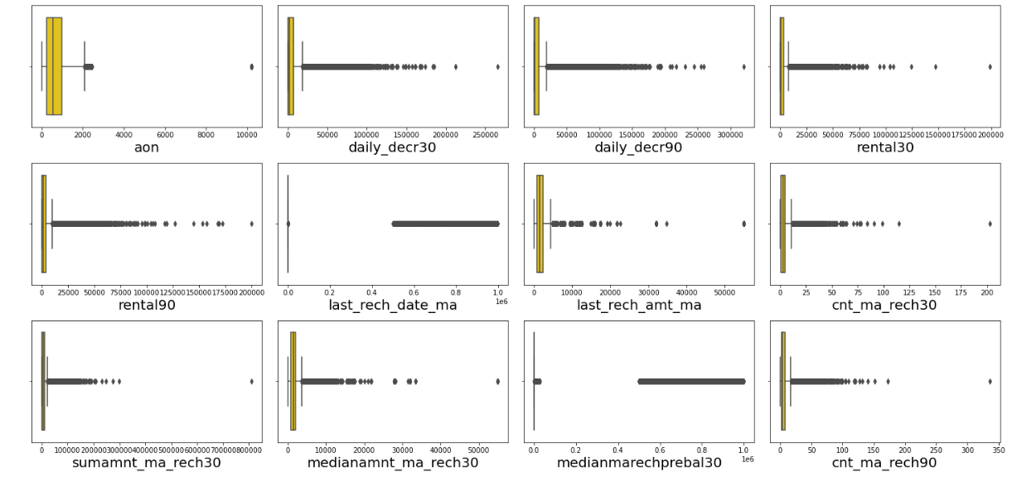
BOXPLOT – TO DETECT OUTLIERS
All the columns has outliers as shown . we will analyse each column and determine whether to remove outliers or not.

Slide 12
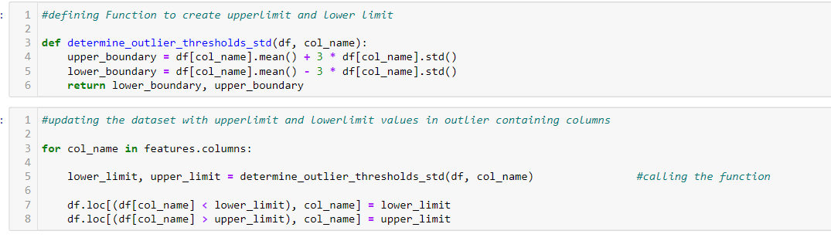
Removing outliers
Tried different methods like z-score and IQR method, std deviation technique to remove outliers. z-score and IQR outlier removal technique was having high data loss ,gone with std deviation technique.

Slide 13
Skewness Removal and multicollinearity
After removing outliers, skewness are removed using Power Transform.
The datum for which skewness is not removed through power transform technique are removed using sqrt,cbrt,log transformation technique.
After removing outliers and Skewness, scaled data to check multicollinearity.
multicollinearity found. And removed the columns with multicollinearity iteratively .Hence proceeded with the data.
Thus data cleaning, feature_selection and EDA done.

Slide 14
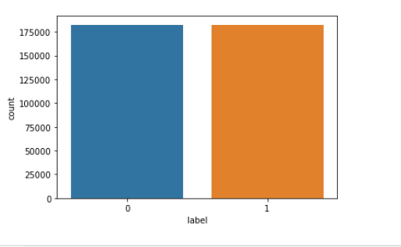
Over Sampling
The dataset is imbalanced, either oversampling to be done or should only check the model accuracy using f1 score. So, oversampling is done to make data balanced. There were 365026 rows and 17 columns to build efficient model after oversampling as shown in figure

Slide 15
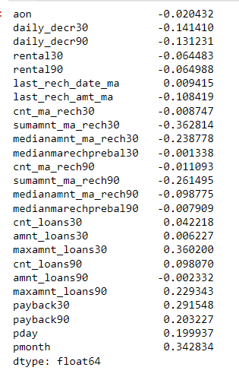
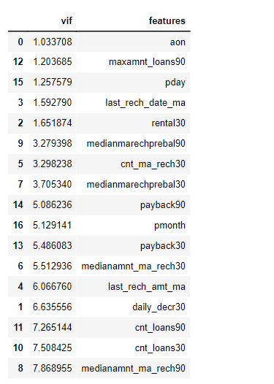
Removed skewness data
Multicollinearity

Slide 16
Model building
X,y initialized
Random_state was found using an algorithm with logistic Regression i,e, 1
Splitted as Train and Test data
Training data consist of 255518rows
Testing data consists of 109508rows (30%)

Slide 17
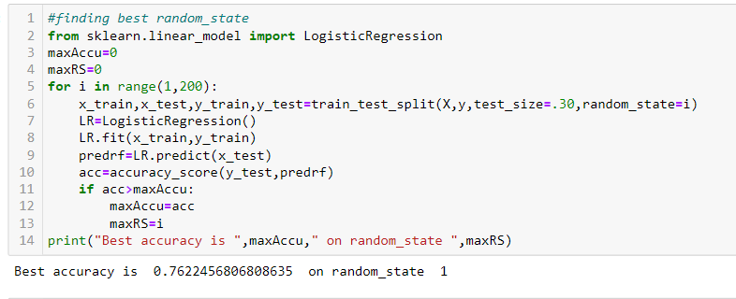
random_state calculation

Slide 18
algorithms
LogisticRegression()
KNeighborsClassifier()
GradientBoostingClassifier()
DecisionTreeClassifier()
RandomForestClassifier()
AdaBoostClassifier()
XGBClassifier()
ExtraTreesClassifier()

Slide 19
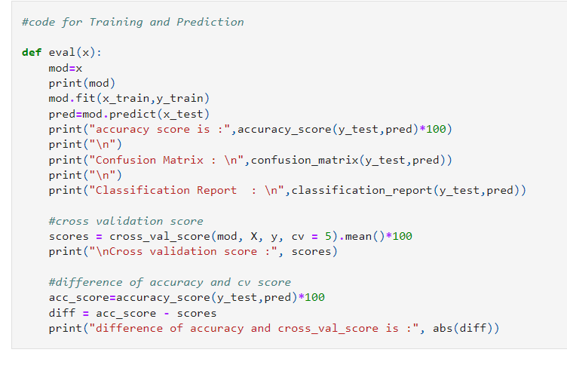
code for Training and Prediction

Slide 20
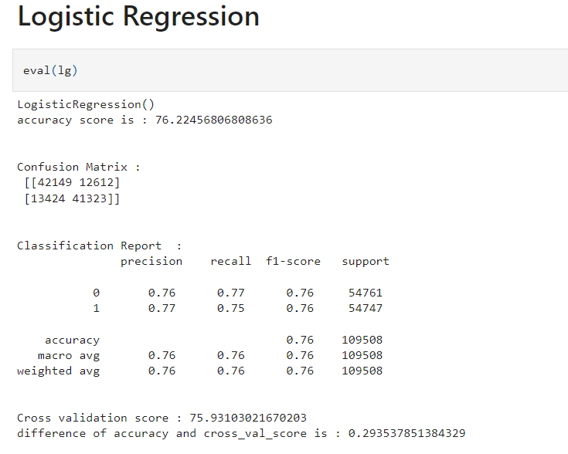
Logistic Regression model is giving an accuracy score of 76.45%

Slide 21
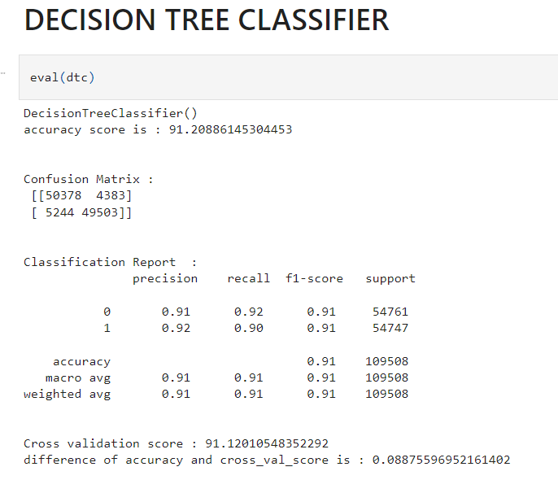
DecisionTreeClassifier model is giving an accuracy score of 91.2% (selected)

Slide 22
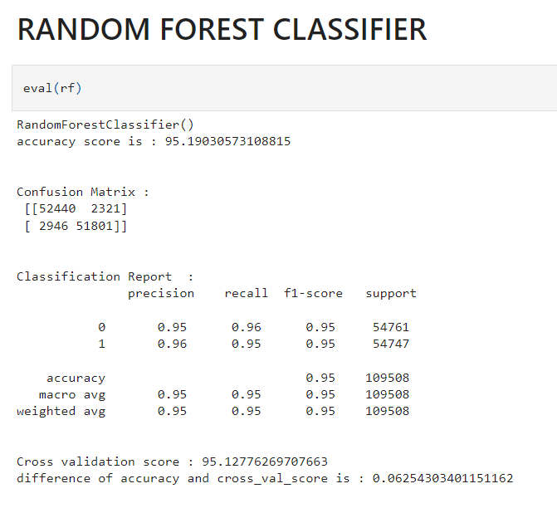
RandomForestClassifier model is giving an accuracy score of 95.1% (selected)

Slide 23
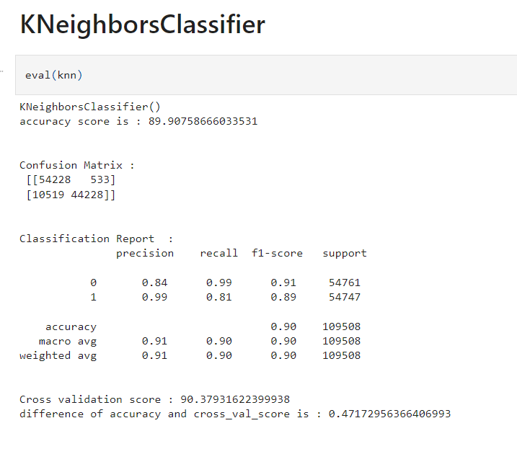
KNeighborsClassifier model is giving an accuracy score of 89.9% (selected)

Slide 24
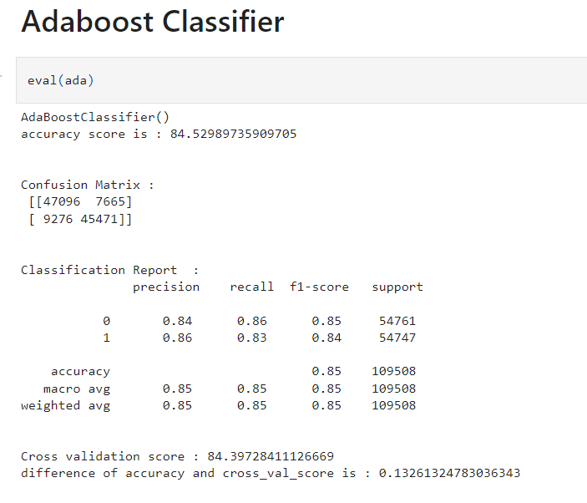
AdaBoostClassifier model is giving an accuracy score of 84.39% (selected)

Slide 25
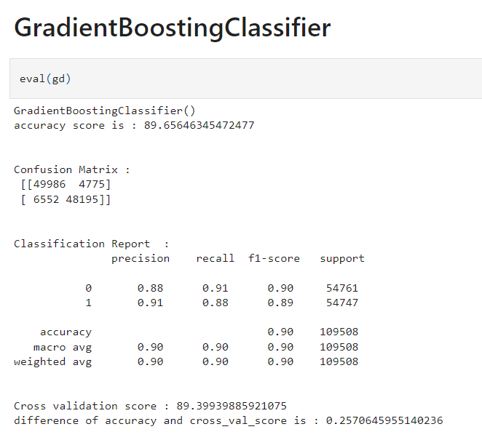
GradientBoostingClassifier model is giving an accuracy score of 89.65% (selected)

Slide 26
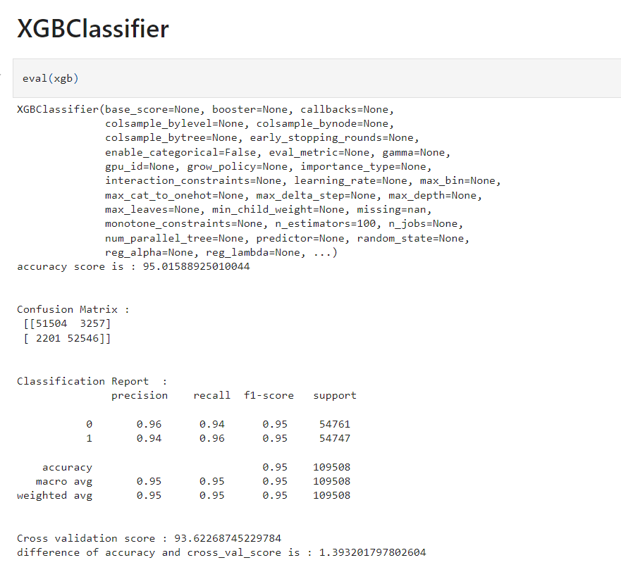
XGBClassifier model is giving an accuracy score of 95.01% (selected)

Slide 27
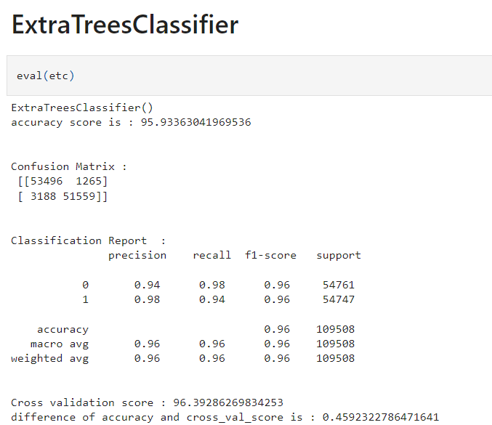
ExtraTreesClassifier model is giving an accuracy score of 95.39% (selected)

Slide 28
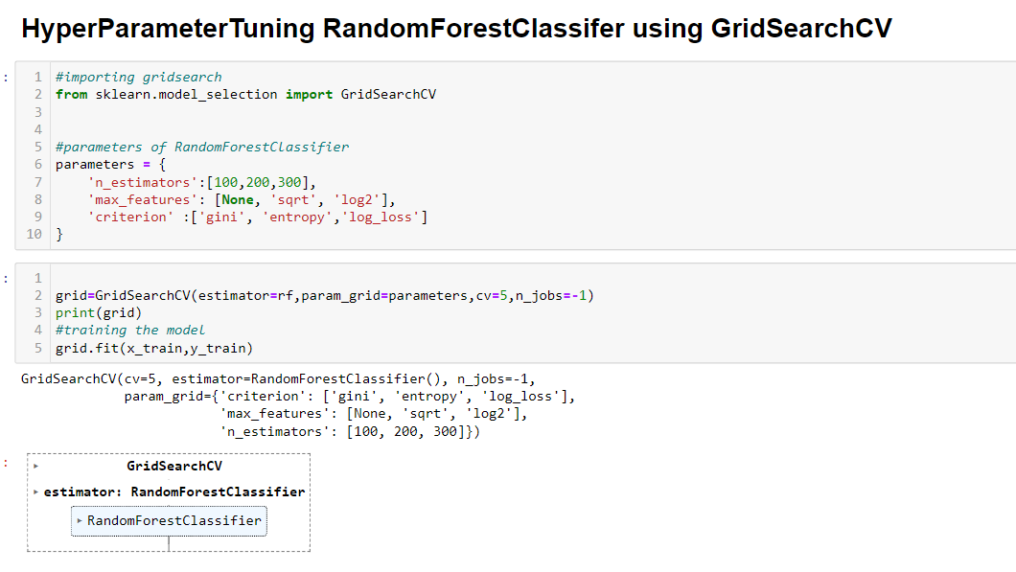
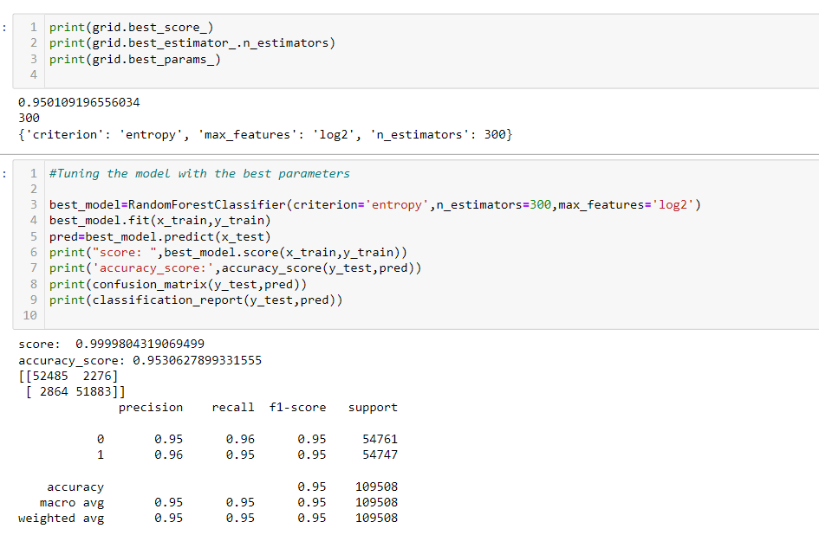
Random forest classifier algorithm is Best to be used as final model. Let us do hyperparameter tuning to check if it is increasing the accuracy
HYPERPARAMETER TUNING (GridsearchCV)
It gives only 95.30% accuracy, as there is increasine in accuracy we can Go with the hupertuned random classifier model.

Slide 29
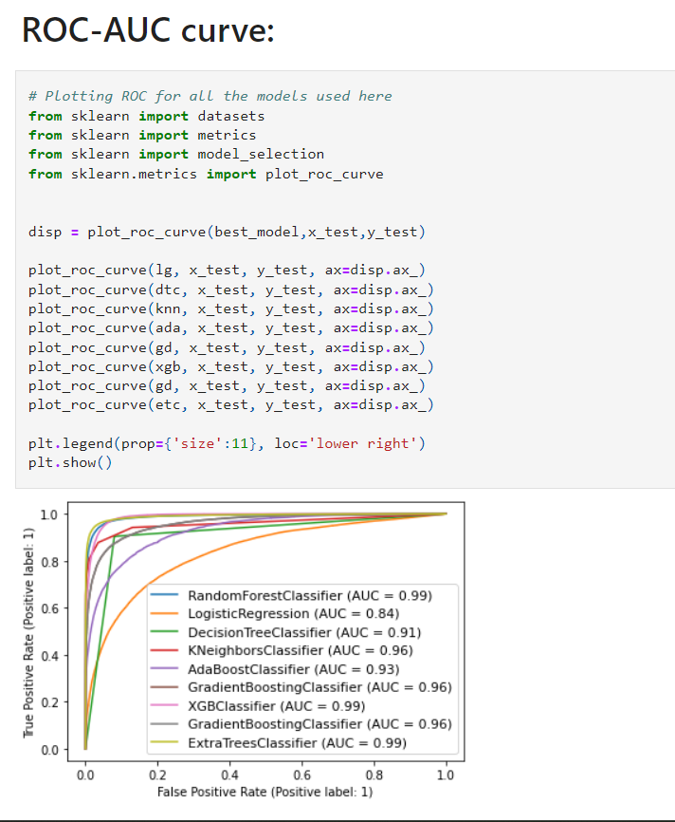
ROC_AUC_CURVE
This curve defines the area under curve and random forest classifier
‘rf’ has the largest area covered under curve among all the algorithm.
(AUC=0.99)

Slide 30
CONCLUSION
After Training and Testing six algorithm model. The best accuracy model was determined as hypertuned random forest classifier with 95.36% true accuracy after all the data cleaning, pre-processing, training and prediction as well as evaluation phase.
Now, Client can easily analyze and choose customers to whom microcredit loan can be provided using this prediction model.

Slide 31
Thank you

